Slide 1


Accessible
Prototyping Software
Phase 1 Presentation
Tristin Bates,

Slide 2




TODAYS
Agenda
The Problem
Gap Analysis
Research Questions
Proposed Direction
Objectives

Slide 3

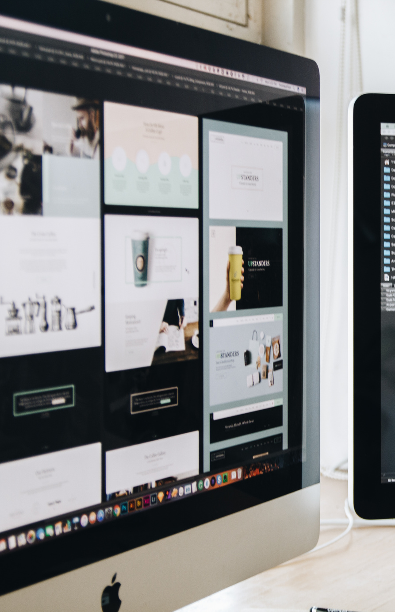

SHORT BRIEF
The
Problem
Current UI prototyping software, such as Figma, often leave many groups of people behind.
Problems
Prototyping tools are visually complex.
Limited support for screen readers and assistive tech.
Steep learning curves for beginners.
Why do these problems matter?
Prototyping is critical for the SDLC
Excludes visually impaired developers and beginners
Reduces collaboration and early feedback.

Slide 4




Gap
Analysis
FILL IN
FILL IN
FILL IN

Slide 5


Questions
Research
How can semantic, intent-driven prototyping allow assistive technologies to interact with and modify prototypes?
How can shared semantic representations support equitable co-design among all team members?

Slide 6

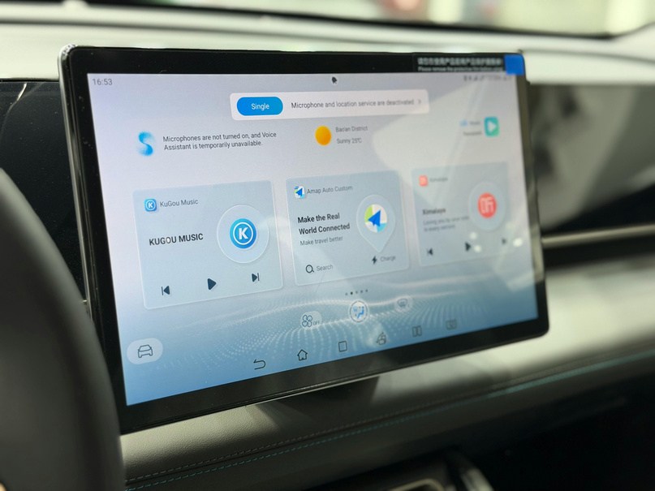

Solution
Objectives
FILL IN
FILL IN

Slide 7
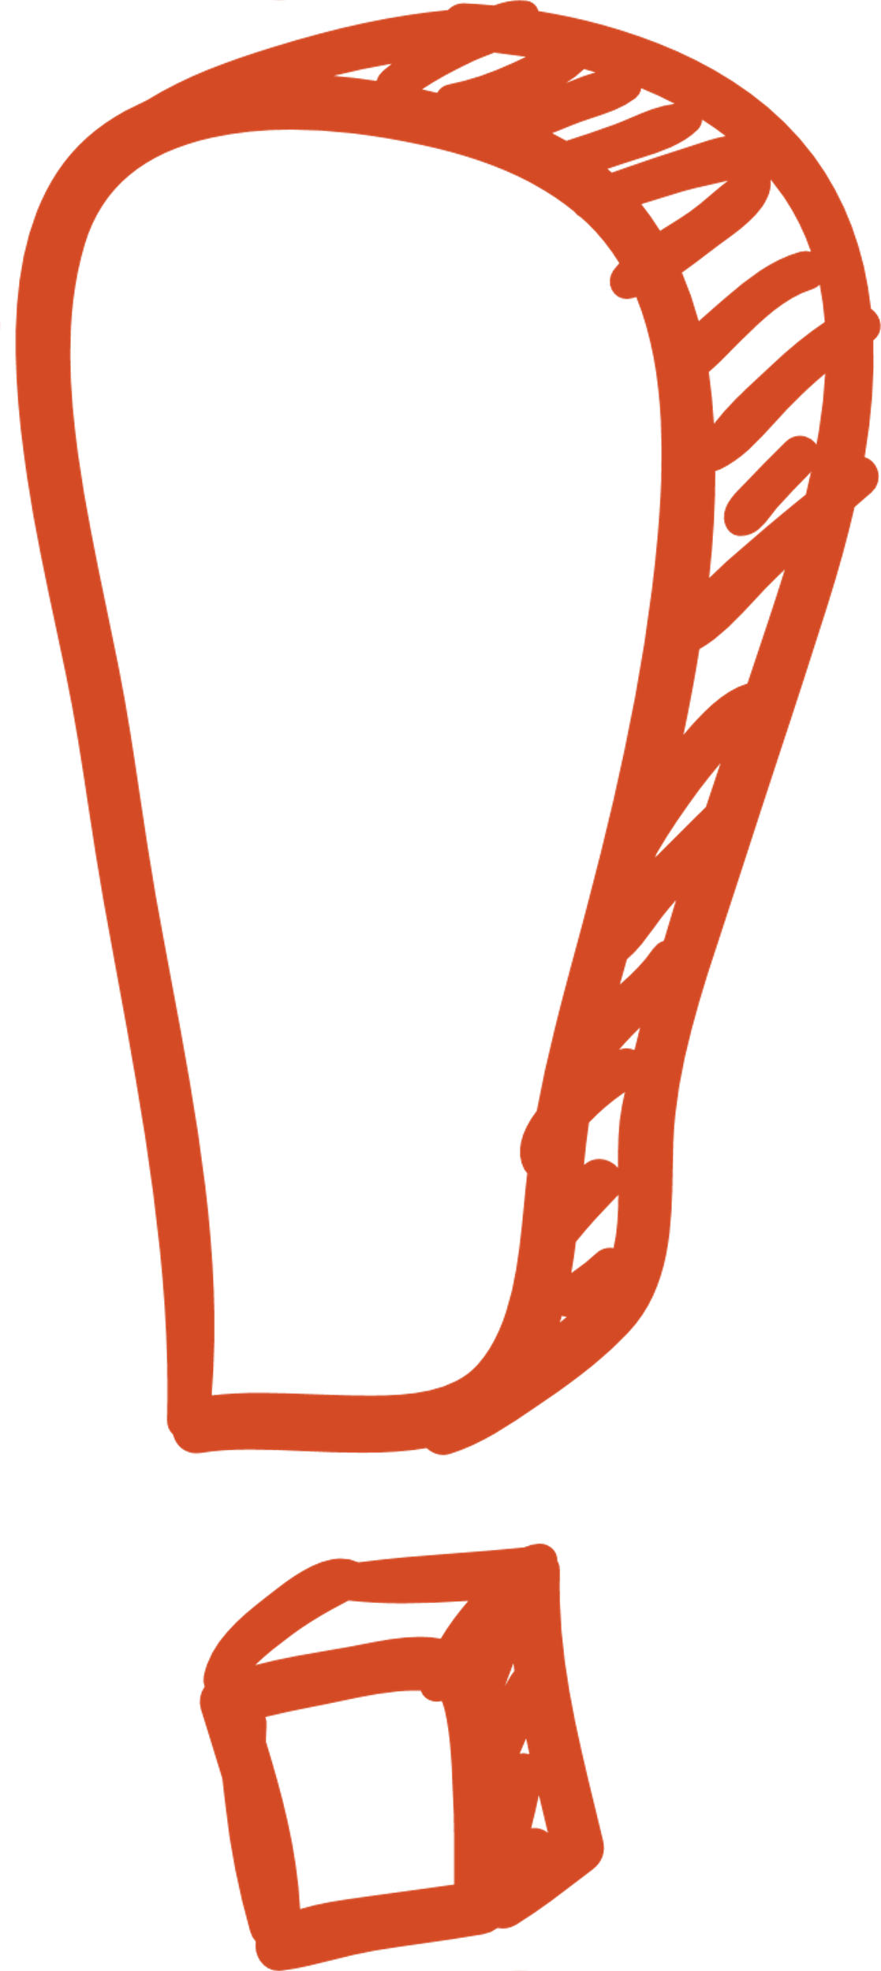

Proposed
FILL IN
Direction
FILL IN
FILL IN

Slide 8

The
End

